Slide 1


Paralleling DC Power Supplies with Droop
Dr. Norbert Doerry and Dr. John V. Amy Jr.
December 11, 2025
http://doerry.org/norbert/MarineElectricalPowerSystems/index.htm
© 2025 by Norbert Doerry and John Amy This work is licensed via: CC BY 4.0 (https://creativecommons.org/)

Slide 2
Introduction
Droop is a technique for allowing two power supplies to share power when paralleled.
Each power supply has a steady state characteristic where the voltage it regulates to is a function of either the power or current.
Normally the relationship is linear: the voltage decreases as load increases
If current is used, the droop characteristic is equivalent to a resistor.
With a linear droop, the droop characteristic is often specified in terms of a percentage drop in voltage (referenced to the nominal no load voltage) at full load.

Slide 3
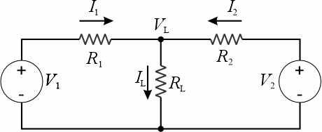
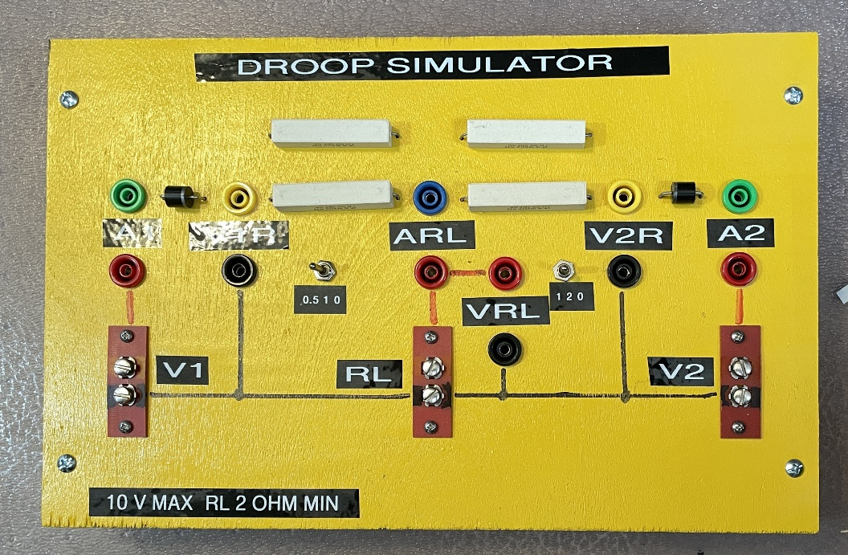
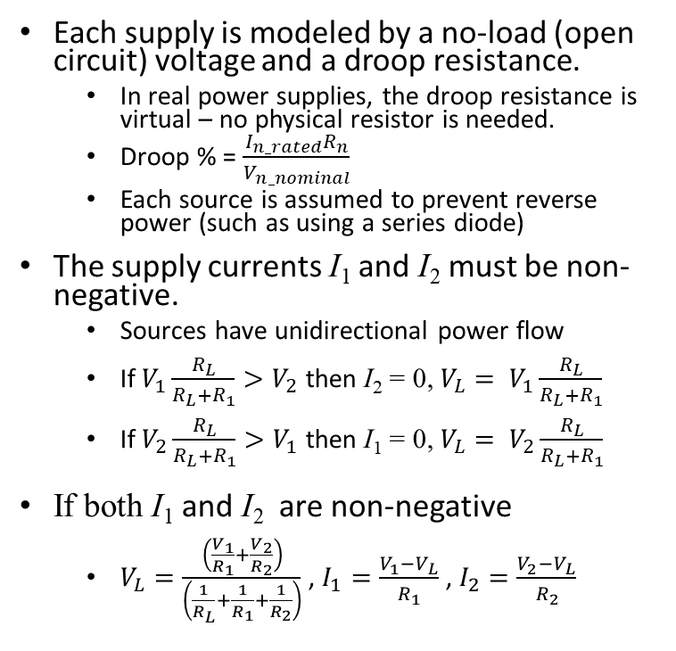
Current based Droop for two dc sources
Each supply is modeled by a no-load (open circuit) voltage and a droop resistance.
In real power supplies, the droop resistance is virtual – no physical resistor is needed.
Droop % = $\frac{I_{n_rated}R_{n}}{V_{n_nominal}}$
Each source is assumed to prevent reverse power (such as using a series diode)
The supply currents I₁ and I₂ must be non-negative.
Sources have unidirectional power flow
If $V_{1}\frac{R_{L}}{R_{L}+R_{1}}>V_{2}$ then I₂ = 0, ${V_{L}= V}_{1}\frac{R_{L}}{R_{L}+R_{1}}$
If $V_{2}\frac{R_{L}}{R_{L}+R_{1}}>V_{1}$ then I₁ = 0, $V_{L}= V_{2}\frac{R_{L}}{R_{L}+R_{1}}$
If both I₁ and I₂ are non-negative
$V_{L}=\frac{\left(\frac{V_{1}}{R_{1}}+\frac{V_{2}}{R_{2}}\right)}{\left(\frac{1}{R_{L}}+\frac{1}{R_{1}}+\frac{1}{R_{2}}\right)}$ , $I_{1}=\frac{V_{1}−V_{L}}{R_{1}}$ , $I_{2}=\frac{V_{2}−V_{L}}{R_{2}}$

Slide 4

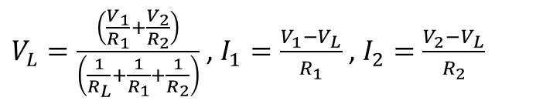
Equal No Load Voltages and Resistances Vary the Load
Set $V_{1}=V_{2}=10 Volts$
Set $R_{1}=R_{2}=1 ohm$
R_{L} | V_{L} | I₁ | I₂ | I_{L}
_{Ohm} | _{Volts} | _{Amps} | _{Amps} | _{Amps}
10 | 9.52 | 0.48 | 0.48 | 0.95
5 | 9.09 | 0.91 | 0.91 | 1.82
3.3 | 8.68 | 1.32 | 1.32 | 2.63
2.5 | 8.33 | 1.67 | 1.67 | 3.33
$V_{L}=\frac{\left(\frac{V_{1}}{R_{1}}+\frac{V_{2}}{R_{2}}\right)}{\left(\frac{1}{R_{L}}+\frac{1}{R_{1}}+\frac{1}{R_{2}}\right)}$ , $I_{1}=\frac{V_{1}−V_{L}}{R_{1}}$ , $I_{2}=\frac{V_{2}−V_{L}}{R_{2}}$
Equal sharing for all loads

Slide 5

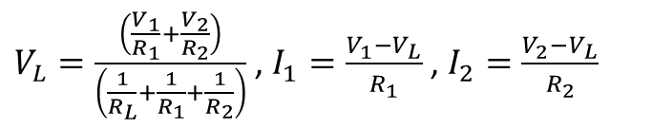
Equal No Load Voltages, Unequal Resistances Vary the Load
Set $V_{1}=V_{2}=10 Volts$
Set $R_{1}=0.5 ohm, R_{2}=1ohm$
R_{L} | V_{L} | I₁ | I₂ | I_{L}
_{Ohm} | _{Volts} | _{Amps} | _{Amps} | _{Amps}
10 | 9.68 | 0.65 | 0.32 | 0.97
5 | 9.38 | 1.25 | 0.63 | 1.88
3.3 | 9.08 | 1.83 | 0.92 | 2.75
2.5 | 8.82 | 2.35 | 1.18 | 3.53
$V_{L}=\frac{\left(\frac{V_{1}}{R_{1}}+\frac{V_{2}}{R_{2}}\right)}{\left(\frac{1}{R_{L}}+\frac{1}{R_{1}}+\frac{1}{R_{2}}\right)}$ , $I_{1}=\frac{V_{1}−V_{L}}{R_{1}}$ , $I_{2}=\frac{V_{2}−V_{L}}{R_{2}}$
Same sharing fraction for all loads

Slide 6

Unequal No Load Voltages, Equal Resistances Vary the Load
Set $V_{1}=10 Volts, V_{2}=11 Volts$
Set $R_{1}=R_{2}=1.0 ohm$
R_{L} | V_{L} | I₁ | I₂ | I_{L}
_{Ohm} | _{Volts} | _{Amps} | _{Amps} | _{Amps}
10 | 10.00 | 0.00 | 1.00 | 1.00
5 | 9.55 | 0.45 | 1.45 | 1.91
3.3 | 9.12 | 0.88 | 1.88 | 2.76
2.5 | 8.75 | 1.25 | 2.25 | 3.50
$V_{L}=\frac{\left(\frac{V_{1}}{R_{1}}+\frac{V_{2}}{R_{2}}\right)}{\left(\frac{1}{R_{L}}+\frac{1}{R_{1}}+\frac{1}{R_{2}}\right)}$ , $I_{1}=\frac{V_{1}−V_{L}}{R_{1}}$ , $I_{2}=\frac{V_{2}−V_{L}}{R_{2}}$
Increasing the voltage of one source creates an offset in current provided

Slide 7

Unequal No Load Voltages (Auctioneering), Equal Resistances, Vary the Load
Set $V_{1}=10 Volts, V_{2}=8 Volts$
Set $R_{1}=R_{2}=1.0 ohm$
R_{L} | V_{L} | I₁ | I₂ | I_{L}
_{Ohm} | _{Volts} | _{Amps} | _{Amps} | _{Amps}
10 | 9.09 | 0.91 | 0.00 | 0.91
5 | 8.33 | 1.67 | 0.00 | 1.67
3.3 | 7.82 | 2.18 | 0.18 | 2.37
2.5 | 7.50 | 2.50 | 0.50 | 3.00
$V_{L}=\frac{\left(\frac{V_{1}}{R_{1}}+\frac{V_{2}}{R_{2}}\right)}{\left(\frac{1}{R_{L}}+\frac{1}{R_{1}}+\frac{1}{R_{2}}\right)}$ , $I_{1}=\frac{V_{1}−V_{L}}{R_{1}}$ , $I_{2}=\frac{V_{2}−V_{L}}{R_{2}}$
If voltage sources are significantly different, the lower voltage source will only contribute at high power levels.
Alternately, if at lower power levels, the lower voltage source will only contribute if the higher voltage source drops offline.

Slide 8

Peak Shaving (Energy Storage) Example
Set $V_{1}=10 Volts, V_{2}=8 Volts$
Set $R_{1}=1.0 ohm, R_{2}=0 ohm$
R_{L} | V_{L} | I₁ | I₂ | I_{L}
_{Ohm} | _{Volts} | _{Amps} | _{Amps} | _{Amps}
10 | 9.09 | 0.91 | 0.00 | 0.91
5 | 8.33 | 1.67 | 0.00 | 1.67
3.3 | 8.00 | 2.00 | 0.42 | 2.42
2.5 | 8.00 | 2.00 | 1.20 | 3.20
$V_{L}=\frac{\left(\frac{V_{1}}{R_{1}}+\frac{V_{2}}{R_{2}}\right)}{\left(\frac{1}{R_{L}}+\frac{1}{R_{1}}+\frac{1}{R_{2}}\right)}$ , $I_{1}=\frac{V_{1}−V_{L}}{R_{1}}$ , $I_{2}=\frac{V_{2}−V_{L}}{R_{2}}$
Minimum Load Voltage fixed, Load current for Source 1 limited

Slide 9
Droop In AC Systems
Frequency droop as a function of real power
As real power supplied by source increases, the frequency decreases
Enables sharing of real power among multiple generators
Voltage droop as a function of current, apparent power, or reactive power
As current, apparent power, or reactive power increases, voltage decreases
Enables sharing of reactive power among multiple generators
If current or apparent power is used, assumes the real power is shared appropriately.

Slide 10
Wrap up

